Slide 1
Semantic Segmentation of Lung and Colon Cancer Histopathological Images Using U-Net
Team (Phoenix) Santosh Bogati
June 8, 2024

Slide 2
Objectives:
Primary Objective: Develop a semantic segmentation model using the U-Net architecture to accurately segment lung and colon cancer histopathological images
Goal: Precise localization of cancerous regions to aid in diagnosis and treatment planning.

Slide 3
Why U-Net?
Pixel-wise Classification: Each pixel in the image is classified, which is essential for tasks like identifying the exact boundaries of a tumor or lesion.
Precise Boundary Detection: U-Net excels in tasks requiring precise delineation of structures within an image, such as segmenting tumors, organs, and other anatomical structures in medical images.

Slide 4
Methodology:
Dataset:
Source: Kaggle
Details: 75 images/category (Reduced because of insufficient spec)
Classes:
Lung benign tissue
Lung adenocarcinoma
Lung squamous cell carcinoma
Colon adenocarcinoma
Colon benign tissue
Preprocessing

Slide 5
Model Implementation:
Architecture: U-Net by Pytorch
Model Layers: Encoder, bottleneck, and decoder with Conv2D and UpSampling2D layers
Training:
Loss function: Binary Crossentropy.
Optimizer: Adam.
Hyperparameters: 30 epochs (initially 50), batch size of 32.

Slide 6
Results:
Model Performance:
Validation Loss: 59%
Validation Accuracy: 9%

Slide 7
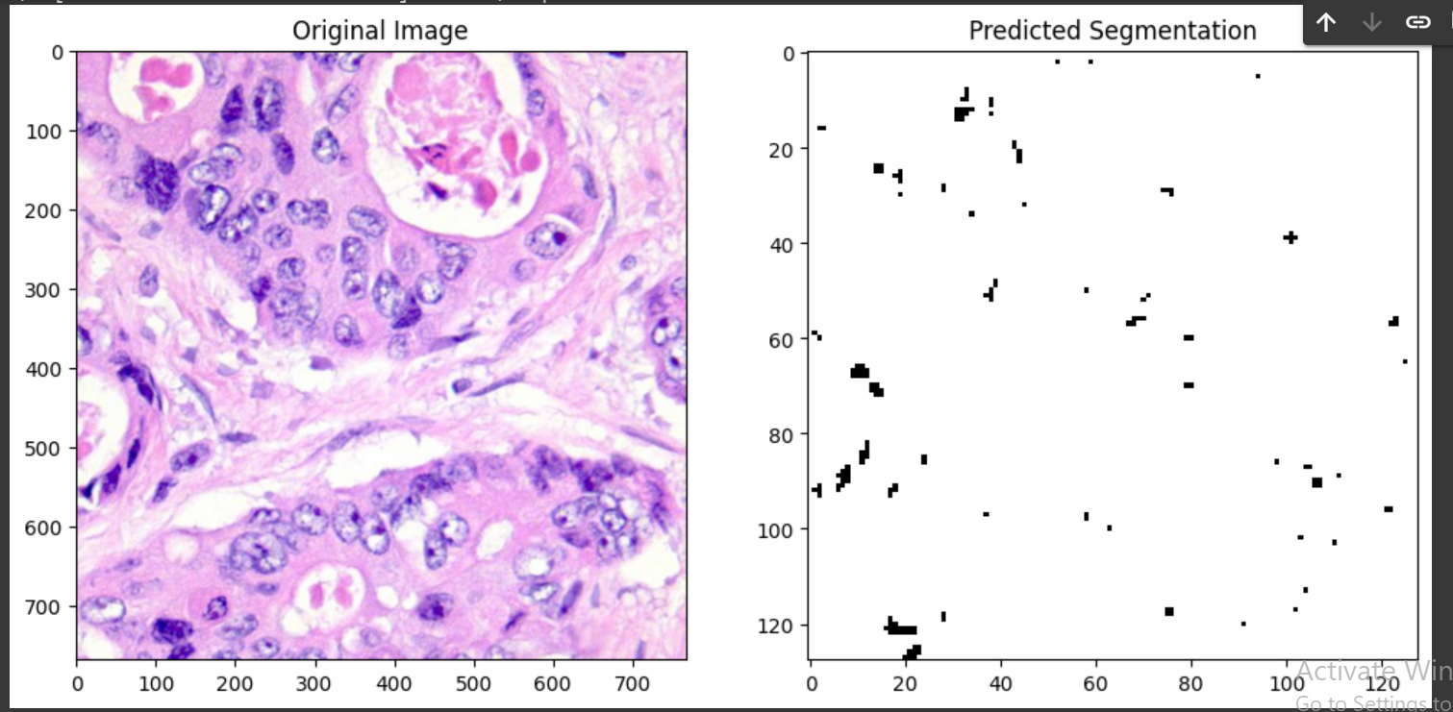
Sample Prediction (Underfitting)

Slide 8
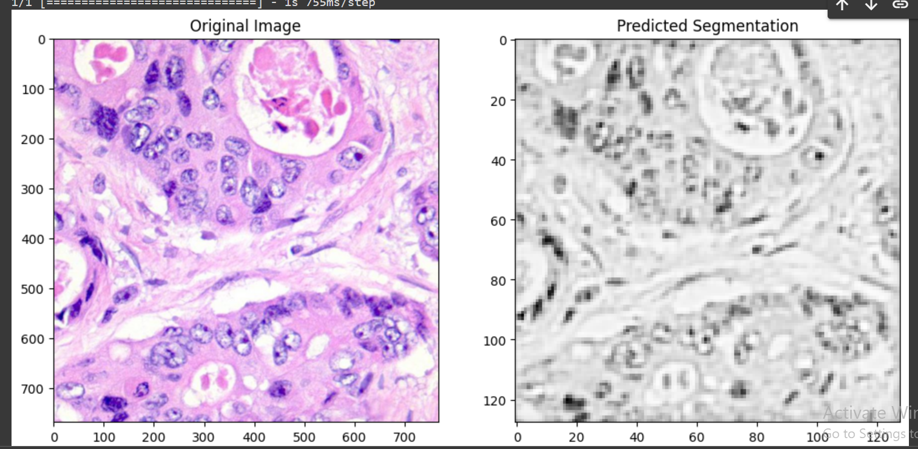
Sample Prediction (Underfitting)

Slide 9
Challenges:
Computational Resources:
Challenge: Limited computational power
Solution: Utilized cloud-based GPUs

Slide 10
Conclusion
Recap:
Developed a U-Net based model for segmenting lung and colon cancer histopathological images.
Take-ways:
Underfitting because of low dataset
ML models are exhaustive

Slide 11
Questions????

